Slide 1
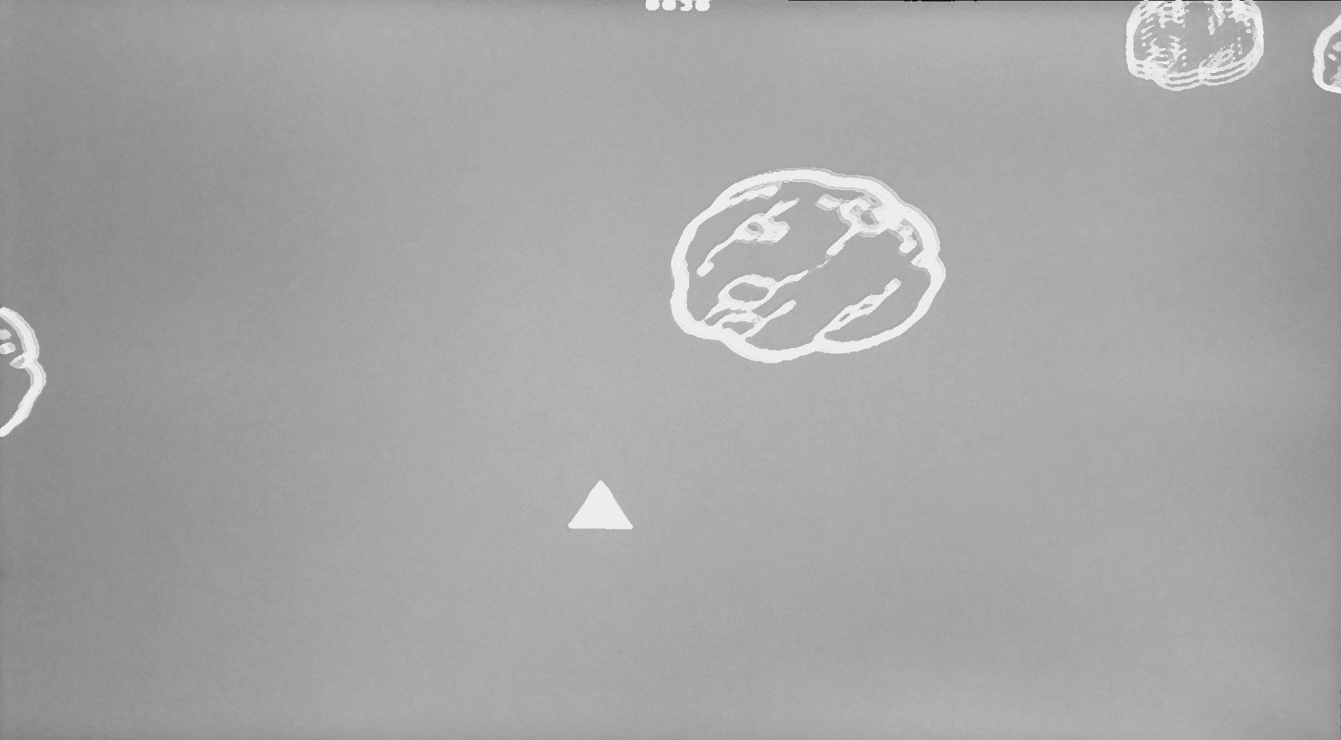
Asteroids Game
Zachary Lee

Slide 2
Relevant/Important
This project takes the concepts of digital system development which we have learned this semester and applies them to create something useful.
VHDL
Megafunctions
Synchronous Design
VGA
This project has given me real world experience developing a digital system to meet specific requirements.

Slide 3
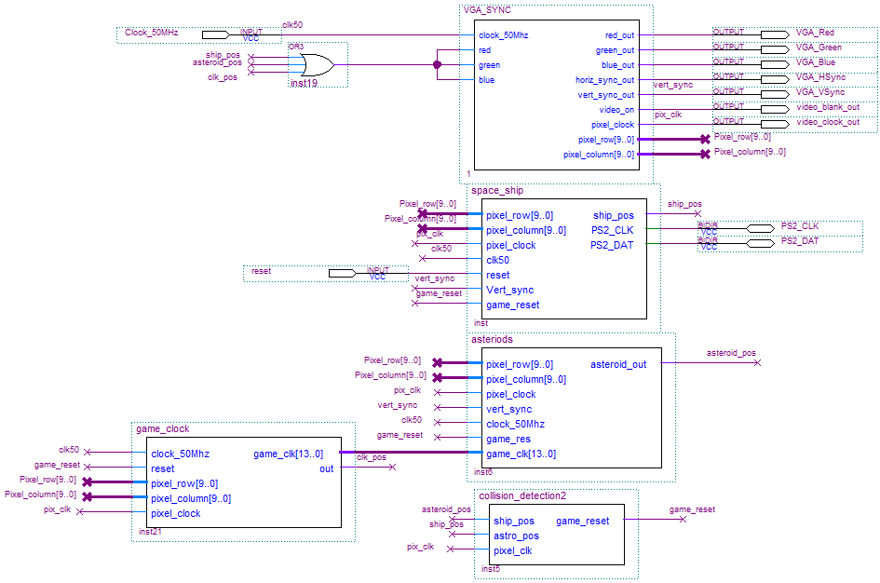
Top-Level Schematic

Slide 4
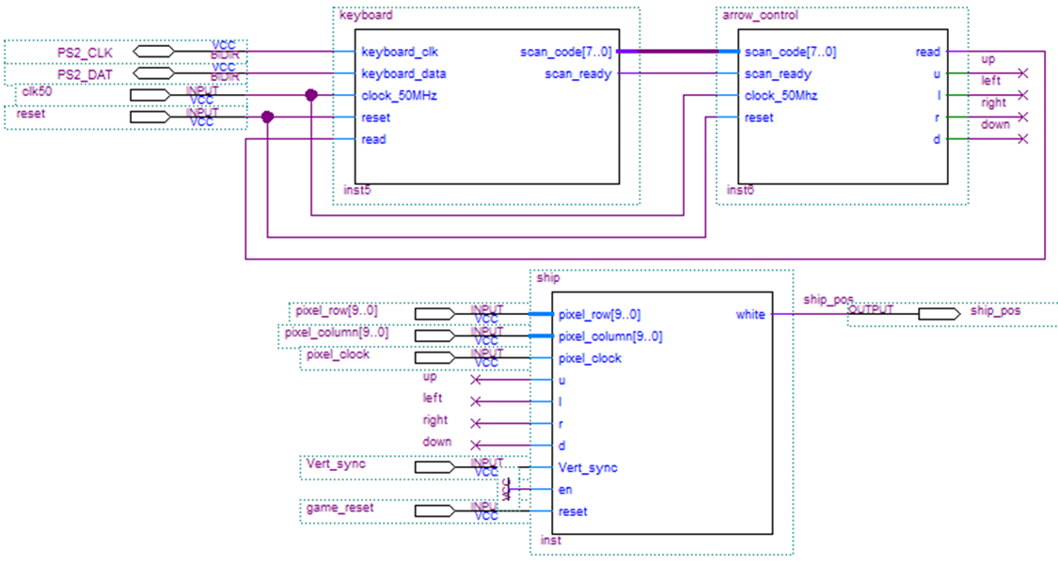
space_ship

Slide 5
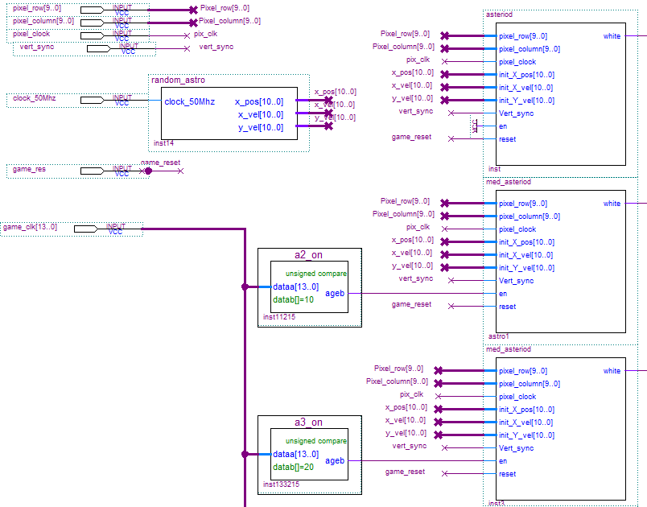
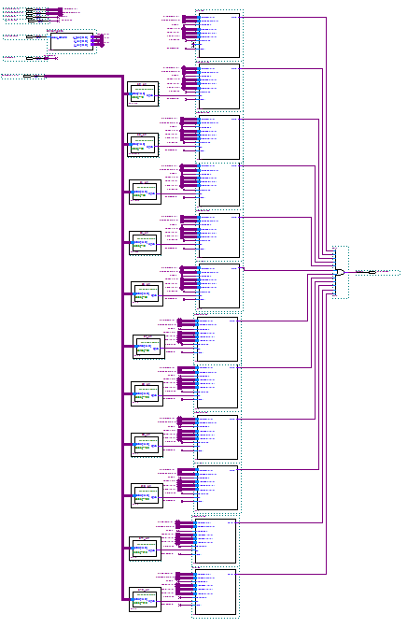
asteroids

Slide 6
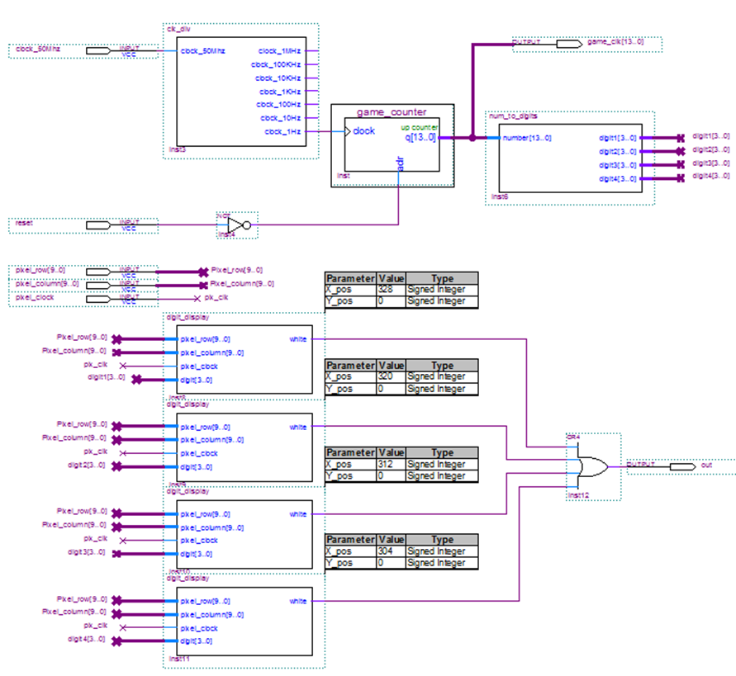
game_clk

Slide 7
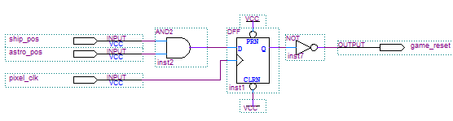
Collision_Detect

Slide 8
DEMO

Slide 9
Currently Working
User Control of Spaceship using Keyboard.
Pseudorandom Asteroid Re-spawn
Smooth Exit for Asteroids
Ship and Asteroid Graphics
Increasing Difficulty as Time Goes On
Score Keeping Clock at Top of Screen

Slide 10
Future Work
Use Ultrasonic Distance Sensor to Control Ship
Allow User to Shoot Lasers to Destroy Asteroids
Power-ups, such as Speed Boost and Shrink

Slide 11
What I Have Learned
Break Complex Designs Down into Smaller Parts
Use Hierarchy and Labels to Make Schematics Simpler
Use Synchronization To Prevent Glitches
Reuse/Modify Existing Modules
Use Parameters
Remain Persistent and Curious

Slide 12
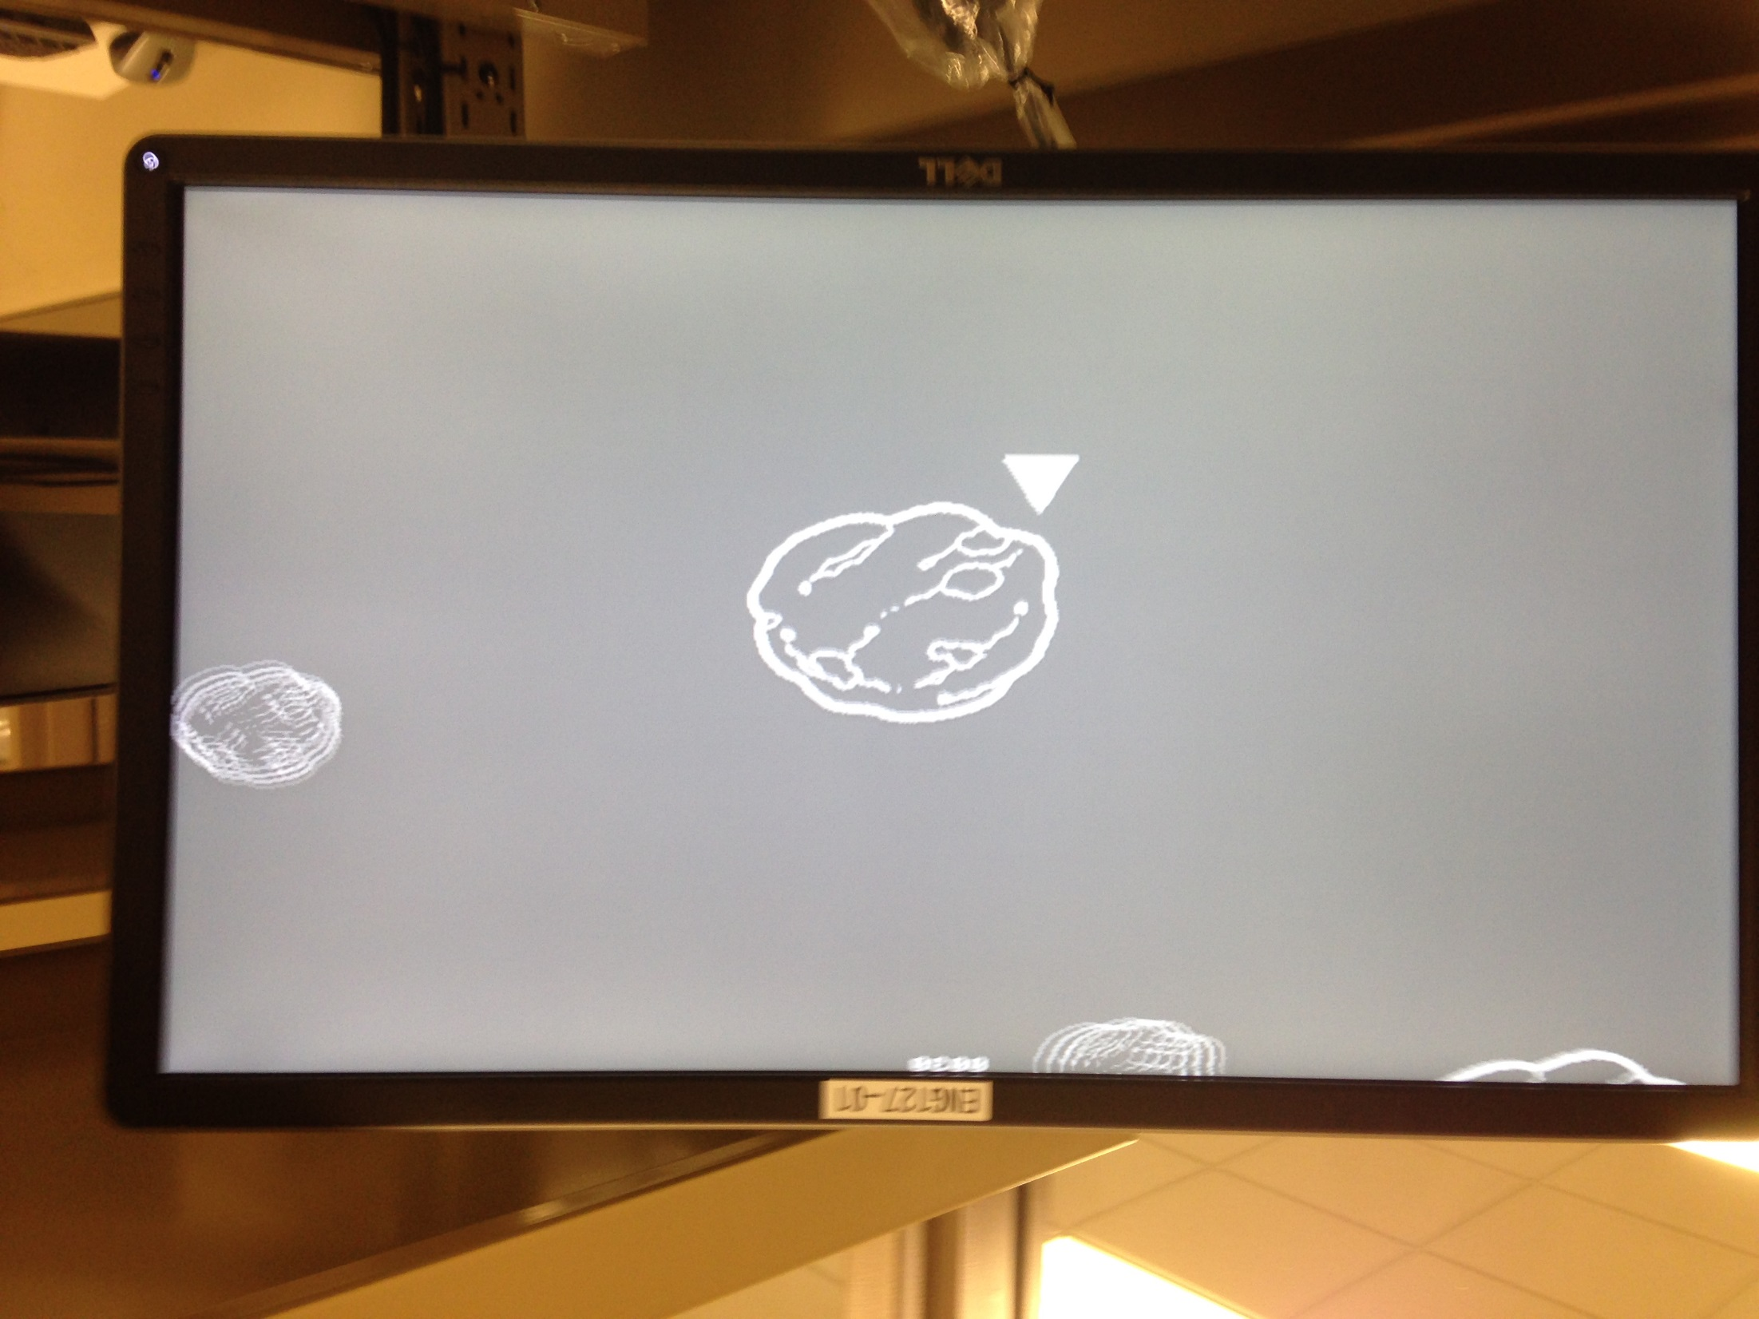
GAME OVER
Questions?

